Slide 1
ISEC Lecture 5b Access Control
Ref: Textbook
Chap 12 - Access Management

Slide 2
Objectives
12.1 Define access management and list the access control models
12.2 List the best practices for access control

Slide 3
What is Access Control?
Access Control
Granting or denying approval to use specific resources
Physical access control
Consists of fencing, hardware door locks, and mantraps to limit contact with devices
Technical access control
Consists of technology restrictions that limit users on computers from accessing data
There are standard access control models that are used to help enforce access control

Slide 4
Access Control Terminology (1 of 5)
Identification
Presenting credentials
Example: delivery driver presenting employee badge
Authentication
Checking the credentials
Example: examining the delivery driver’s badge
Authorization
Granting permission to take action
Example: allowing delivery driver to pick up package
Accounting
A record that is preserved of who accessed the network, what resources they accessed, and when they disconnected

Slide 5
Access Control Terminology (2 of 5)
Action | Description | Scenario example | Computer process
Identification | Review of credentials | Delivery person shows employee badge | User enters user name
Authentication | Validate credentials as genuine | Gabe reads badge to determine it is real | User provides password
Authorization | Permission granted for admittance | Gabe opens door to allow delivery person in | User authorized to log in
Access | Right given to access specific resources | Delivery person can only retrieve box by door | User allowed to access only specific data
Accounting | Record of user actions | Gabe signs to confirm the package was picked up | Information recorded in log file

Slide 6
Access Control Terminology (3 of 5)
Object
A specific resource
Example: file or hardware device
Subject
A user or process functioning on behalf of a user
Example: computer user
Operation
The action taken by the subject over an object
Example: deleting a file

Slide 7
Access Control Terminology (4 of 5)
Role | Description | Duties | Example
Privacy officer | Manager who oversees data privacy compliance and manages data risk | Ensures the enterprise complies with data privacy laws and its own privacy policies | Decides that users can have permission to access SALARY.X L S X
Custodian or steward | Individual to whom day-to-day actions have been assigned by the owner | Periodically reviews security settings and maintains records of access by end users | Sets and reviews security settings on SALARY.X L S X
Owner | Person responsible for the information | Determines the level of security needed for the data and delegates security duties as required | Determines that the file SALARY.X L S X can be read only by department managers
End user | User who access information in the course of routine job responsibilities | Follows organization’s security guidelines and does not attempt to circumvent security | Opens SALARY.X L S X

Slide 8
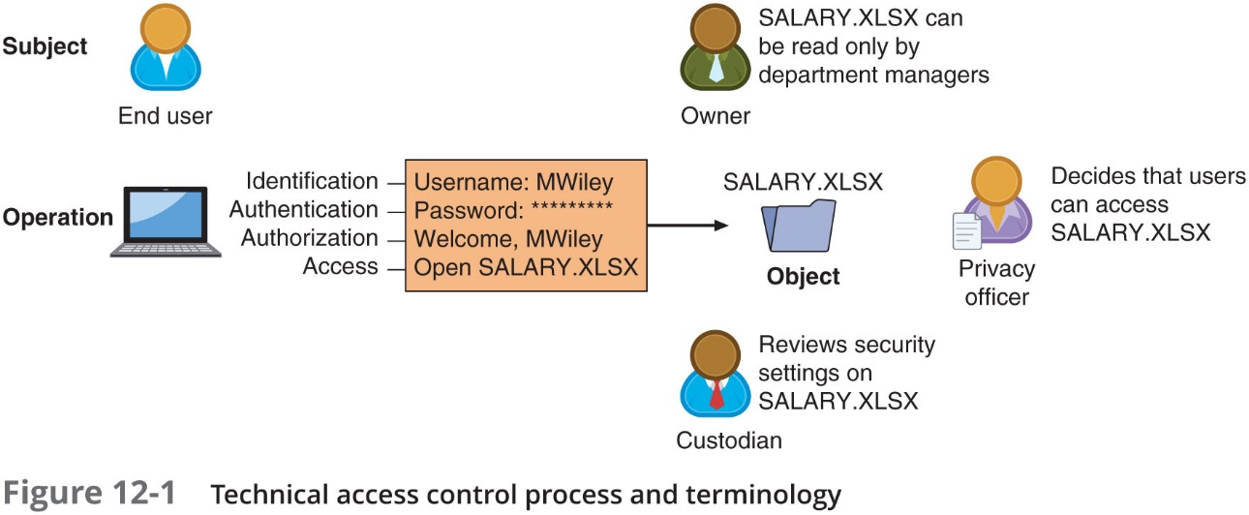
Access Control Terminology (5 of 5)

Slide 9
Access Control Models
Access control model
Standards that provide a predefined framework for hardware or software developers
Use the appropriate model to configure the necessary level of control
Five major access control models
Discretionary Access Control (D A C)
Mandatory Access Control (M A C)
Role Based Access Control (R B A C)
Rule Based Access Control (RB-RBAC)
Attribute-Based Access Control (A B A C)

Slide 10
Discretionary Access Control (D A C) (1 of 2)
Least restrictive model
Every object has an owner
Owners have total control over their objects
Owners can give permissions to other subjects over their objects
Used on operating systems such as most types of U N I X and Microsoft Windows
Two significant weaknesses:
Poses a risk in that it relies on decision by the end user to set the proper level of security
A subject’s permissions will be “inherited” by any programs that the subject executes

Slide 11
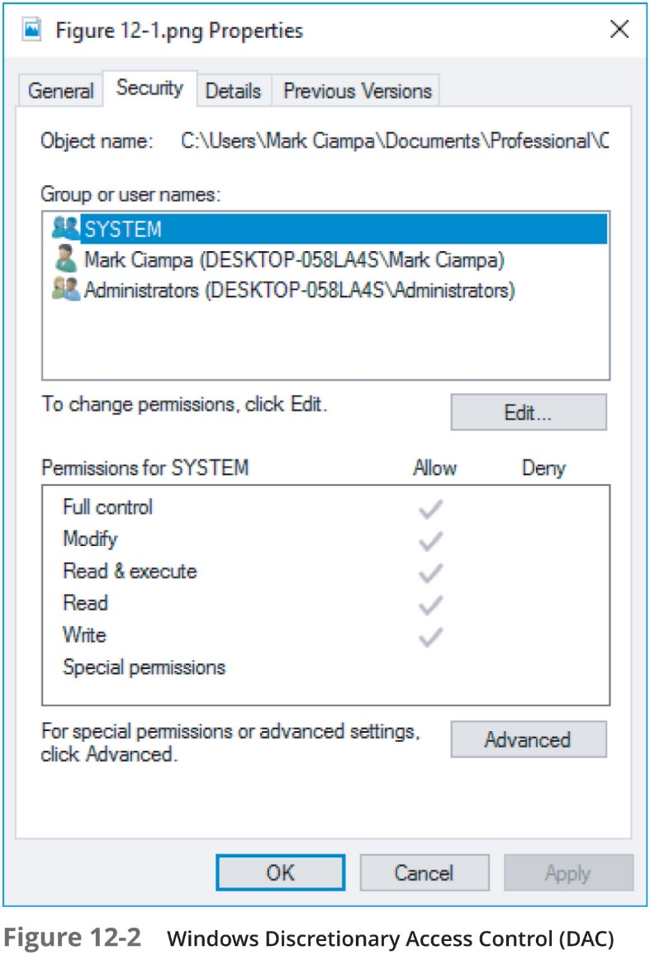
Discretionary Access Control (D A C) (2 of 2)

Slide 12
Mandatory Access Control (M A C) (1 of 4)
Most restrictive access control model
User has no freedom to set any controls or distribute access to other subjects
Typically found in military settings
Two elements
Labels - Every entity is an object and is assigned a classification label that represents the relative importance of the object
Subjects are assigned a privilege label (clearance)
Levels - a hierarchy based on the labels is used
Top secret has a higher level than secret, which has a higher level than confidential

Slide 13
Mandatory Access Control (M A C) (2 of 4)
M A C grants permissions by matching object labels with subject labels based on their respective levels
To determine if file may be opened:
Object and subject labels are compared
The subject must have equal or greater level than object to be granted access

Slide 14
Mandatory Access Control (M A C) (3 of 4)
Microsoft Windows uses a M A C implementation called Mandatory Integrity Control (M I C)
A security identifier (S I D) is issued to the user, group, or session
Each time a user logs in, the S I D is retrieved from the database for that user
S I D is used to identify user with subsequent interactions with Windows
Windows links the S I D to an integrity level
To write or delete an object, the integrity level of the subject must be equal or greater than the object’s level
User Access Control (U A C) - a Windows feature that controls user access to resources

Slide 15
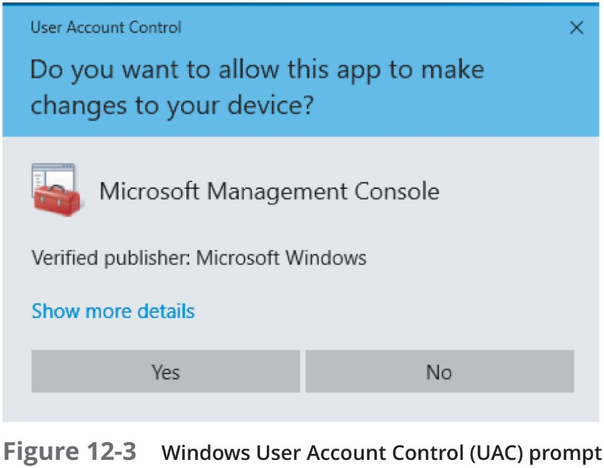
Mandatory Access Control (M A C) (4 of 4)

Slide 16
Role-Based Access Control
Role Based Access Control (R B A C)
Also called Non-Discretionary Access Control
Access permissions are based on user’s job function
R B A C assigns permissions to particular roles in an organization
Users are assigned to those roles

Slide 17
Rule-Based Access Control
Also called Rule-Based Role-Based Access Control (R B-R B A C)
Dynamically assigns roles to subjects based on a set of rules defined by a custodian
Each resource object contains access properties based on the rules
When user attempts access, system checks object’s rules to determine access permission
Often used for managing user access to one or more systems
Business changes may trigger application of the rules specifying access changes

Slide 18
Attribute-Based Access Control (1 of 2)
Uses more flexible polices than Rule-Based A C
Can combine attributes
Policies can take advantage of attributes such as:
Object attributes
Subject attributes
Environment attributes e.g. time of access
A B A C rules can be formatted using an If-Then-Else structure

Slide 19
Attribute-Based Access Control (2 of 2)
Name | Explanation | Description
Mandatory Access Control (M A C) | End user cannot set controls | Most restrictive model
Discretionary Access Control (D A C) | Subject has total control over objects | Least restrictive model
Role-Based Access Control (R B A C) | Assigns permissions to particular roles in the organization and then users are assigned to roles | Considered a more “real-world” approach
Rule-Based Access Control | Dynamically assigns roles to subjects based on a set of rules defined by a custodian | Used for managing user access to one or more systems
Attribute-Based Access Control (A B A C) | Uses policies that can combine attributes | Most flexible model

Slide 20
Best Practices for Access Control
Establishing best practices for limiting access
Can help secure systems and data
Examples of best practices
Separation of duties
Job rotation
Mandatory vacations
Clean desk policy

Slide 21
Separation of Duties
Separation of duties
Fraud can result from a single user being trusted with complete control of a process
Requires two or more people responsible for functions related to handling money
The system is not vulnerable to actions of a single person
In relation to computer access control
Requires that if the fraudulent application of a process could potentially result in a breach of security, the process should be divided between two or more individuals

Slide 22
Job Rotation
Individuals periodically moved between job responsibilities
Employees can rotate within their department or across departments
Advantages of job rotation
Limits amount of time individuals are in a position to manipulate security configurations
Helps expose potential avenues for fraud
Individuals have different perspectives and may uncover vulnerabilities
Reduces employee “burnout”

Slide 23
Mandatory Vacations
Limits fraud, because perpetrator must be present daily to hide fraudulent actions
Audit of employee’s activities usually scheduled during vacation for sensitive positions

Slide 24
Clean Desk Policy
Designed to ensure that all confidential or sensitive materials are removed form a user’s workspace and secured when the items not in use
Either in paper form or electronic
Sample statements that might be found in a clean desk policy:
Computer workstations must be locked when the workspace is unoccupied and turned off at the end of the day
Confidential or sensitive information must be removed from the desk and locked in a drawer or safe when the desk is unoccupied or at the end of a work day
File cabinets must be kept closed and locked when not in use or not attended, and keys may not be left at an unattended desk
Laptops must be either locked with a locking cable or locked in a drawer or filing cabinet

Slide 25
Chapter Summary
Access control is the process by which resources or services are denied or granted
Five major access control models:
Discretionary Access Control, Mandatory Access Control, Role-Based Access Control, Rule-Based Access Control, Attribute-Based Access Control
Best practices for implementing access control
Separation of duties, job rotation, mandatory vacations, and following a clean desk policy

